Slide 1





The Your Heart Speaks Program:
Elevating Patient voices in ANOCA Research
Dr Sarena La
Postdoctoral Researcher
Translational Vascular Function Research Collaborative, Basil Hetzel Institute & The Queen Elizabeth Hospital
Adelaide Medical School, The University of Adelaide

Slide 2
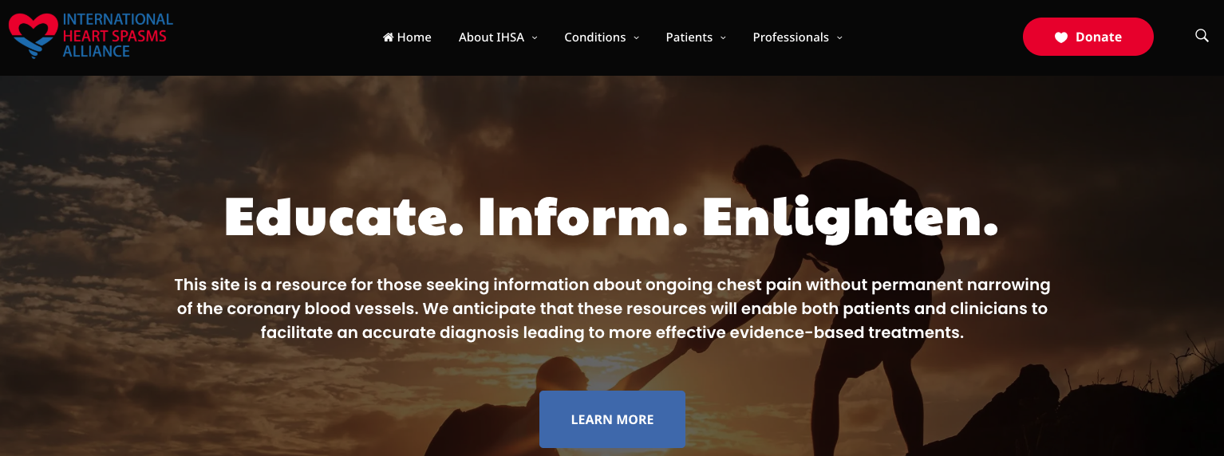


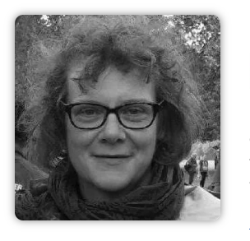
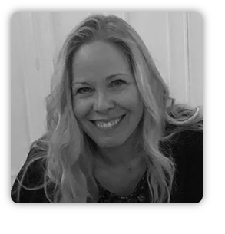
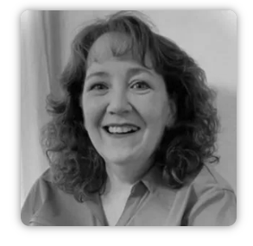
The International Heart Spasms Alliance (IHSA)
Cindy M
Australia
Sarah B
United Kingdom
Annette P
United States of America
Terri S
United States of America

Slide 3

The Your Heart Speaks Program
Aims:
Of those living with ANOCA*/MINOCA**, to:
Capture patient-reported experiences
Explore sex-specific factors on chest pain symptoms in women
Identify and address gaps in health literacy
Elevate the patient voice through equal partnership with patient advocates in all stages.
*ANOCA = Angina with Non-Obstructive Coronary Arteries
**MINOCA = Myocardial Infarction with Non-Obstructive Coronary Arteries

Slide 4
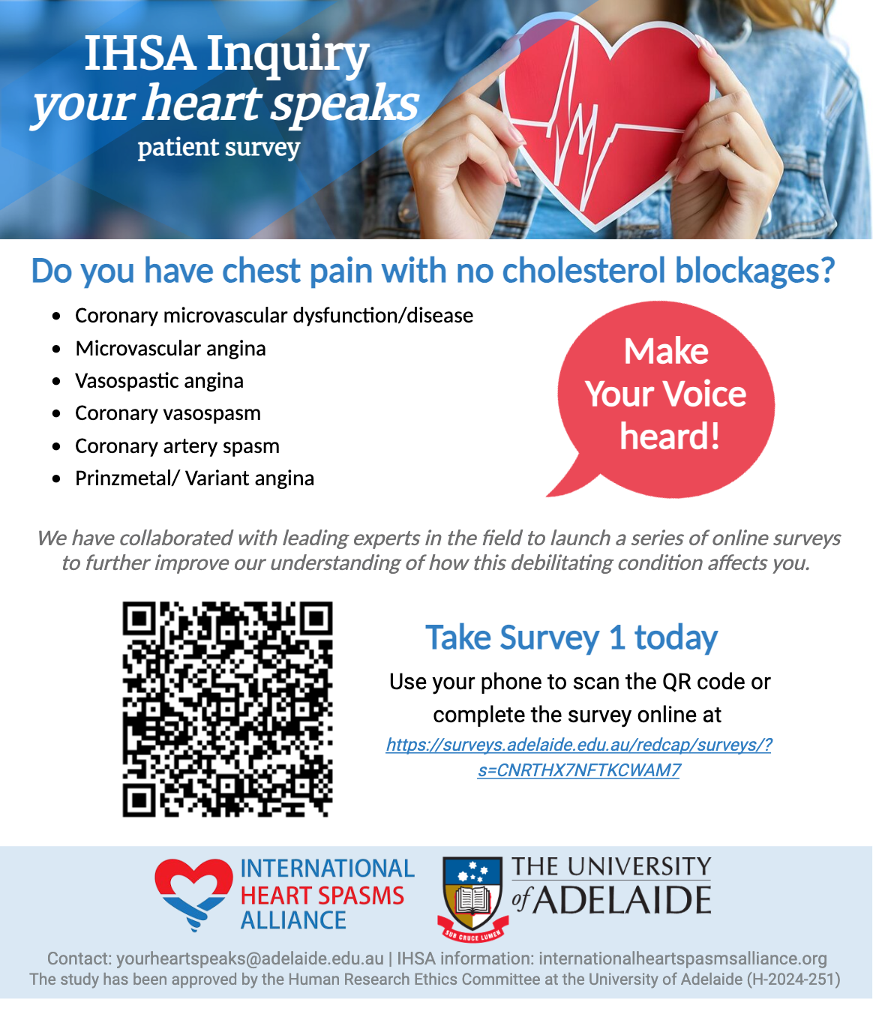

The Your Heart Speaks Program
Methods:
1. Co-design with Experts by Experience
Patient-led series of surveys with the co-founders of IHSA
2. Infrastructure & recruitment - REDCap
Advertisements distributed by the co-founders of IHSA
Survey available to those with ANOCA/MINOCA globally
3. Survey series and Timeline
Surveys released with answers linked via email address
Released at three-month intervals with two months to be included in summary results
January 2025 – Survey 1 launch (clinical characteristics)
April 2025 – Survey 2 launch (chest pain characteristics)
June 2025 – Survey 3 launch (lifestyle impact)
The Your Heart Speaks Program Advertisement Infographic

Slide 5
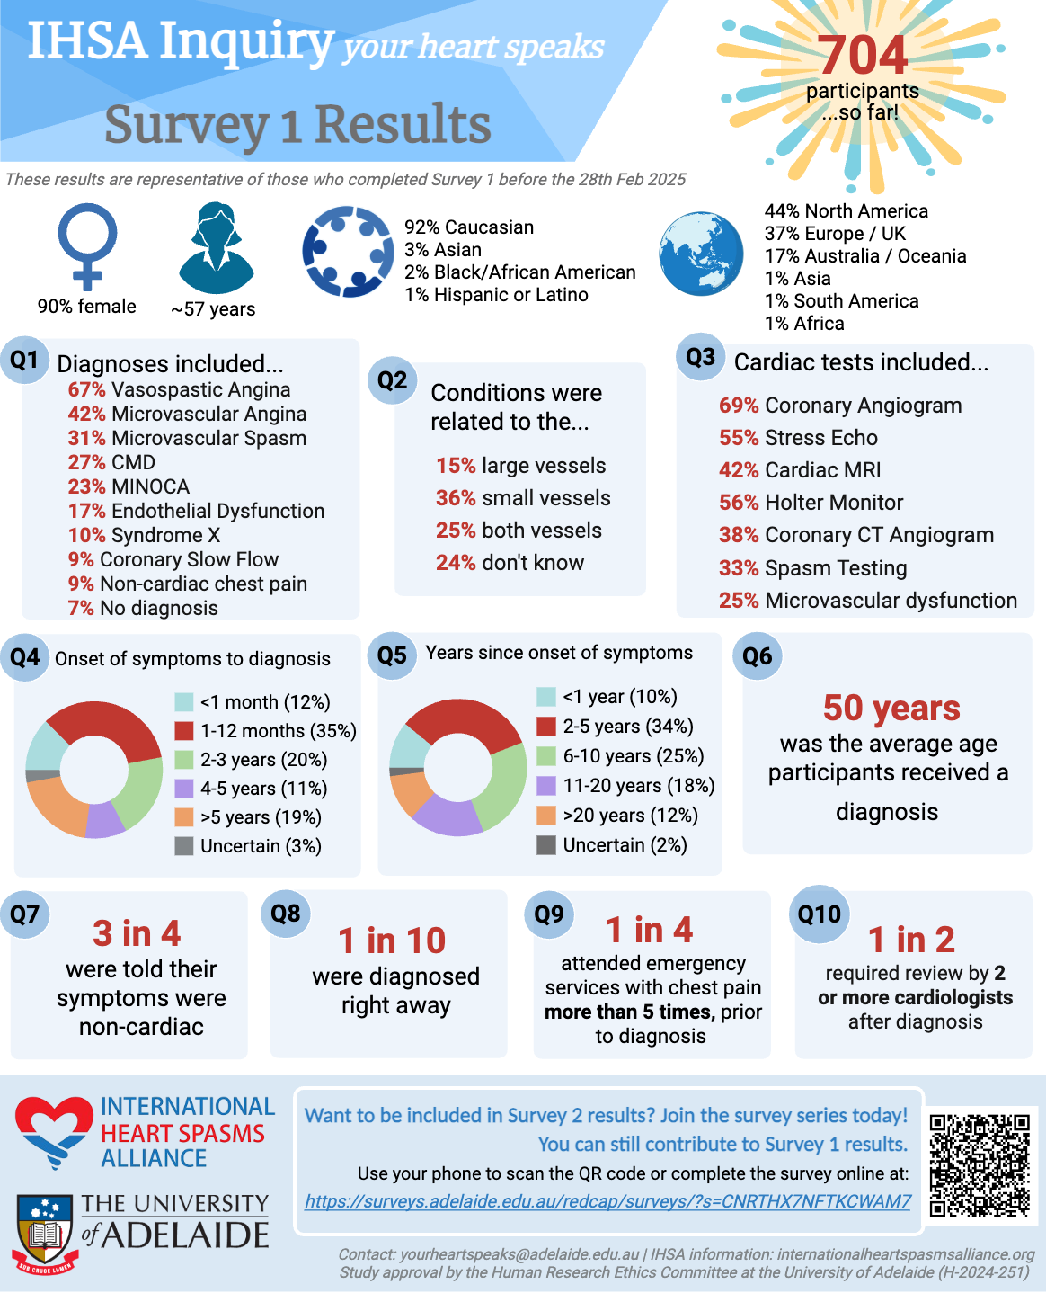
The Your Heart Speaks Program
Survey 1 – clinical characteristics
Key findings:
Vasospastic Angina as most common diagnosis
3 in 4 participants were told that their symptoms were non-cardiac (i.e. anxiety or depression)
There were diagnostic delays, with only 1 in 10 participants diagnosed promptly
1 in 4 attended emergency services with chest pain more than 5 times prior to receiving a diagnosis
Discussion:
Greater clinical awareness and understanding of ANOCA is urgently needed
Diagnostic pathways must be improved to reduce diagnostic delays

Slide 6





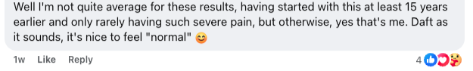
Participant survey feedback – summary results

Slide 7
Future directions
Currently:
928 survey 1 completed
709 (76%) survey 2 completed
519 (73%) survey 3 completed
Continue survey distribution with new ‘themes’
Increase participant recruitment
Creating educational materials for participants to improve health literacy
Webinars and educational material
Continuously improving the program through feedback

Slide 8
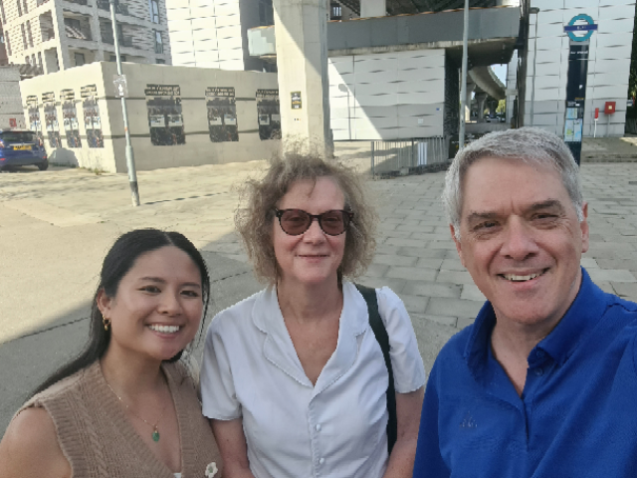
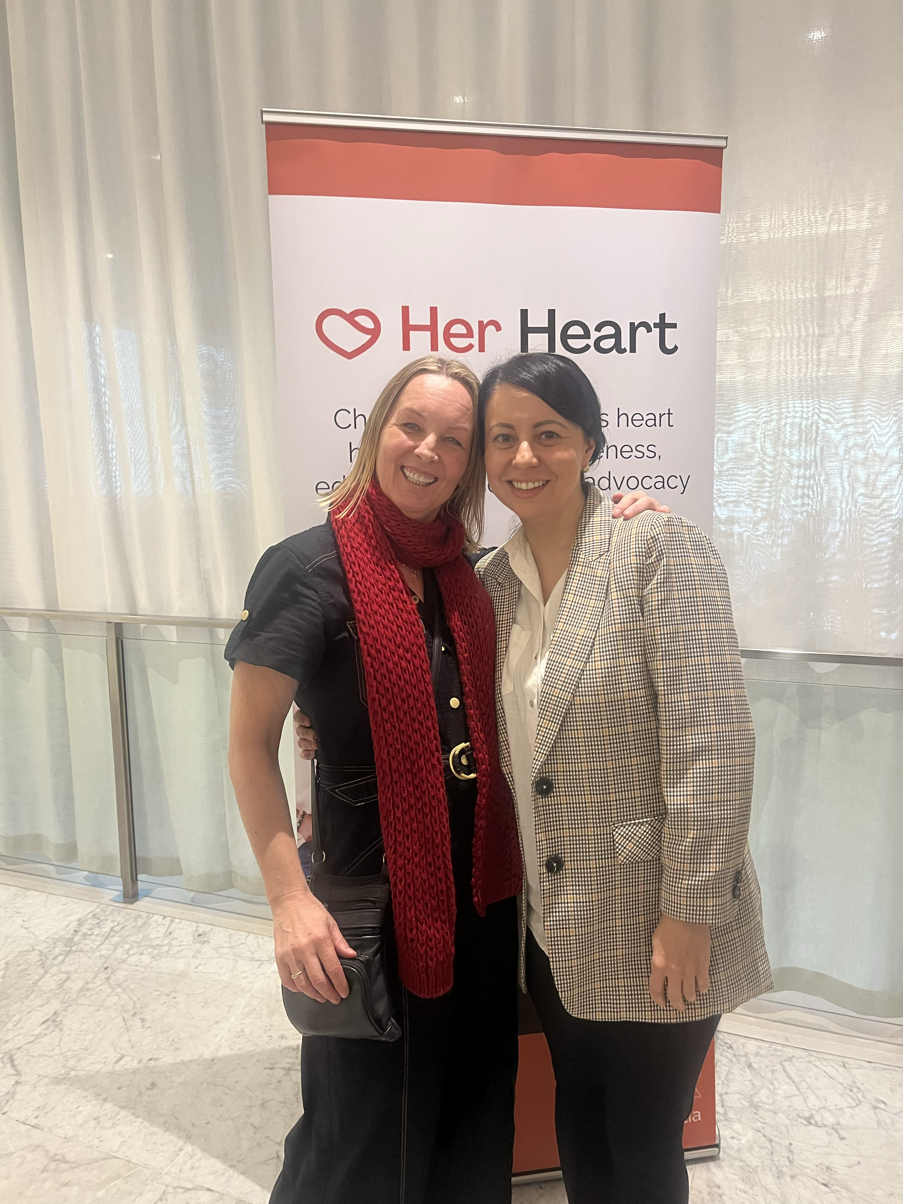
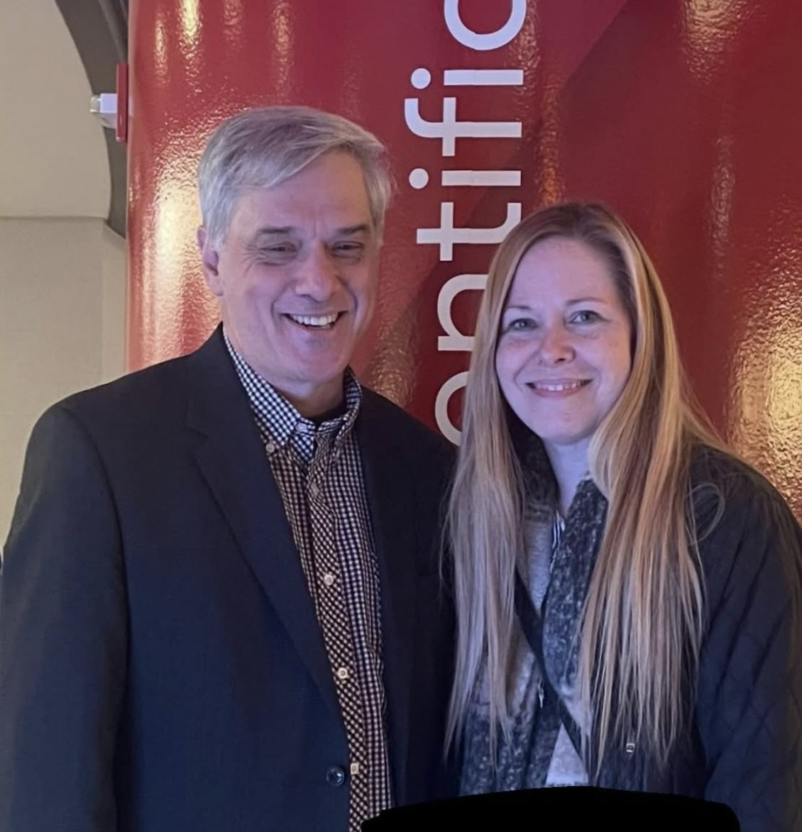


Acknowledgements
Sarah, London
Translational Vascular Function Research Collaborative
A/Prof. Rosanna Tavella
Prof. John Beltrame
International Heart Spams Alliance
Cindy McCall (AUS)
Sarah Brown (UK)
Annette Pompa (USA)
Terri Schumaker (USA)
Dr Sarena La is funded by the SA CVRN Heart Foundation Kick Start Fellowship 2025
Cindy, Melbourne
Annette, Philadelphia

